Slide 1
Problem 15
FIRE-SHOT-FIRE
Kamil Dutkiewicz – Team Poland – IPT 2023 Paris

Slide 2
Problem statement
It is well known that a directed air blast can suppress fire.
Usually such air blasts are directed by guiding the air through a pipe.
Determine the parameters of the pipe to extinguish fire from maximum distance (measured from the end of the tube closest to the fire) using only your breath.
Perform experiments on the fire from a candle.

Slide 3

Experimental setup
laser pointer
pipe
candle

Slide 4



Experimental setup

Slide 5
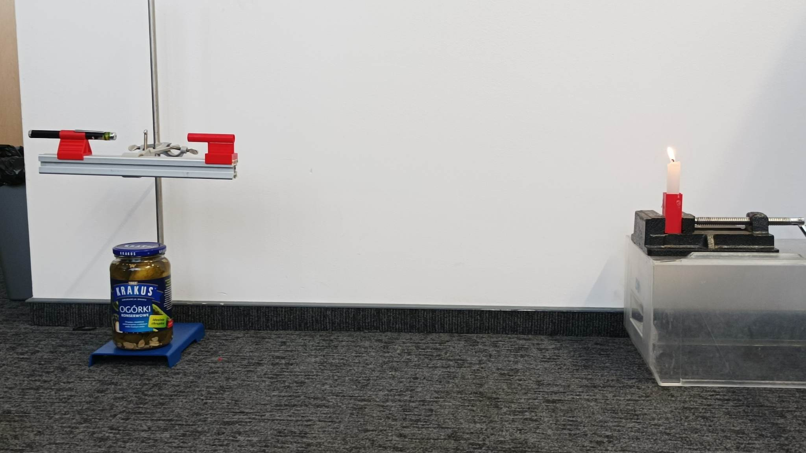
Experimental setup

Slide 6
Decomposition of the process
The human
The pipe
The air jet
The candle

Slide 7
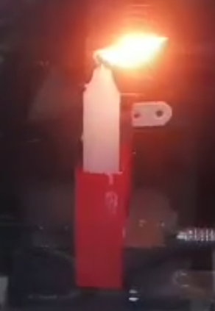
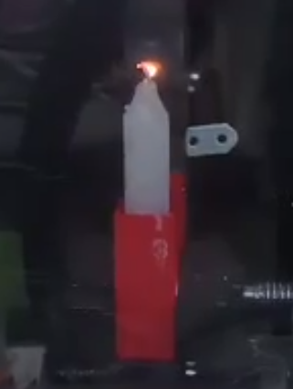
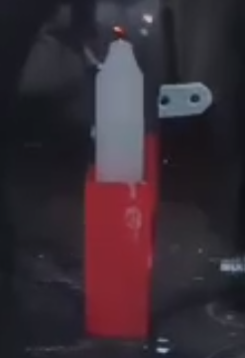
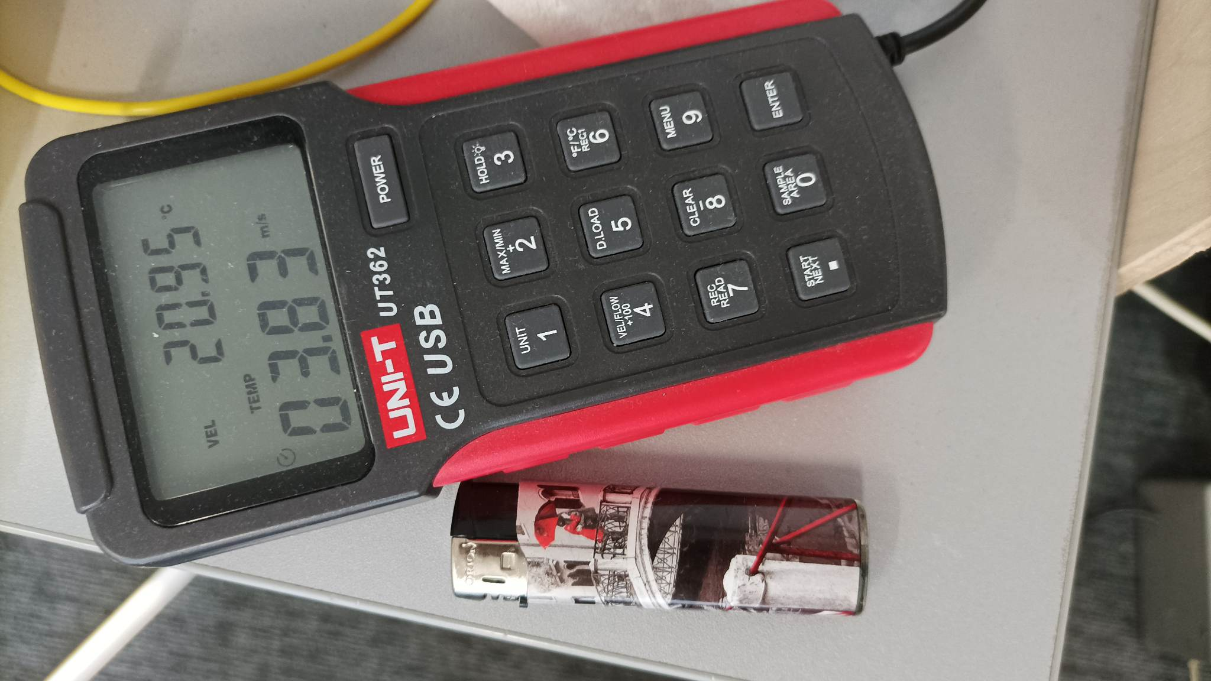
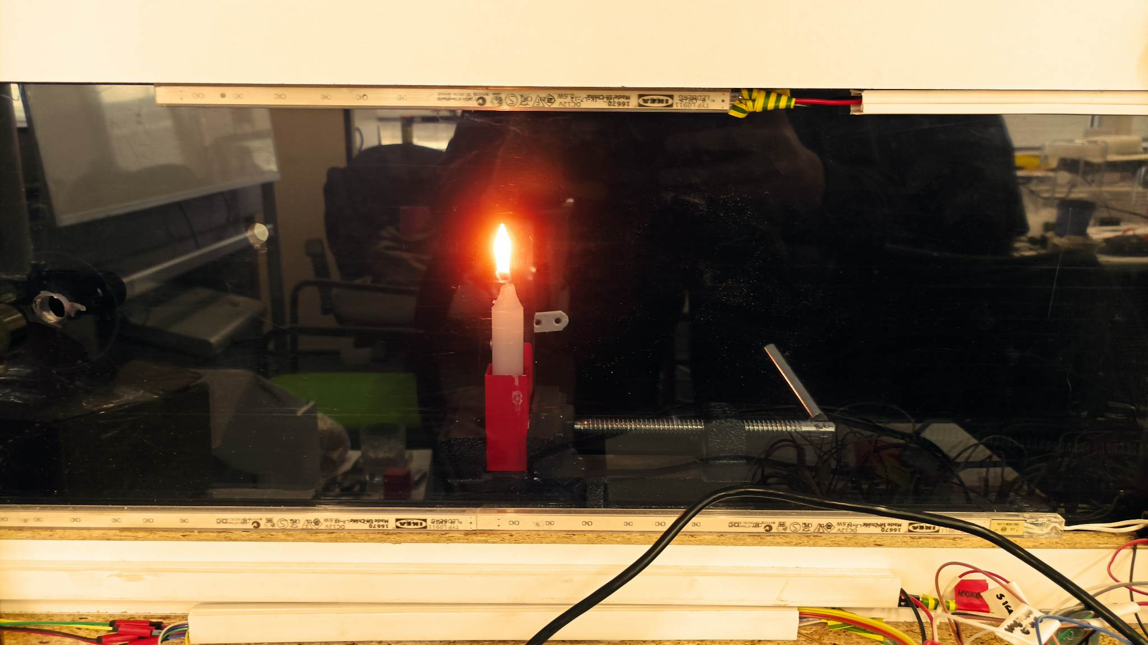
The candle
The candle will get snuffed out in air with moving at some critical velocity U*
U*
Wind tunnel

Slide 8
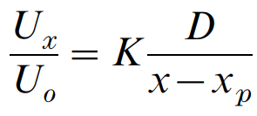
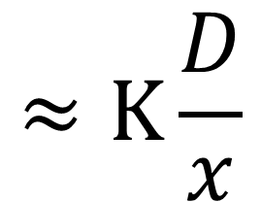
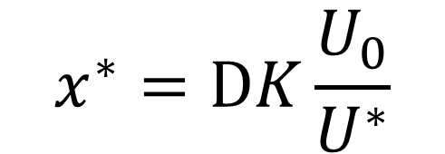
The air jet
K is a dimensionless constant, dependent on the angle of the cone
Centreline velocity decay measurements in low-velocity axisymmetric jets
TOR G. MALMSTRÖM, ALLAN T. KIRKPATRICK, BRIAN CHRISTENSEN and KEVIN D. KNAPPMILLER, 1997
$$≈K\frac{D}{x}$$
$$x^{∗}=DK\frac{U_{0}}{U^{∗}}$$
x
x_{p}
D
U₀
U_{x}
L

Slide 9
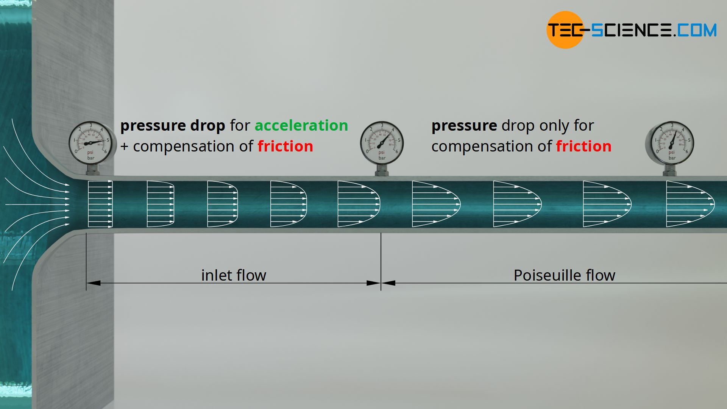
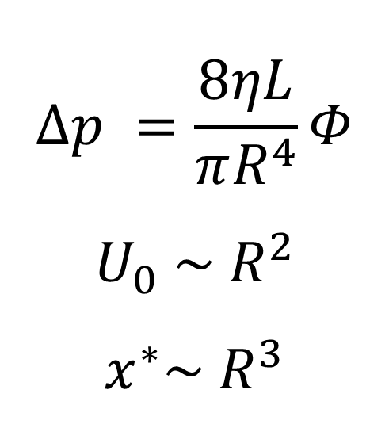

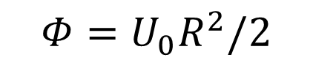
The pipe
$$Φ=U_{0}R^{2}/2$$
$Φ$ – volumetric flowrate
$$Δp =\frac{8ηL}{πR^{4}}Φ$$
$$U_{0} \sim R^{2}$$
$$x^{∗}\sim { R}^{3}$$
Hagen-Poiseuille law
https://www.tec-science.com/mechanics/gases-and-liquids/hagen-poiseuille-equation-for-pipe-flows-with-friction/
https://www.tec-science.com/mechanics/gases-and-liquids/energetic-analysis-of-the-hagen-poiseuille-law

Slide 10
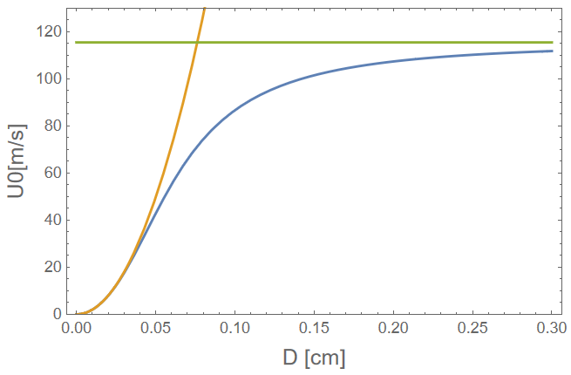
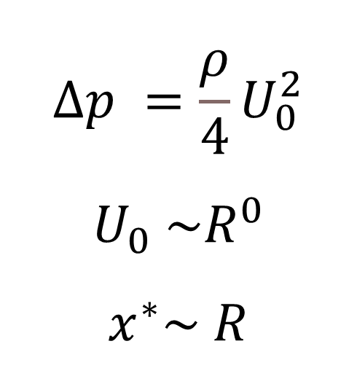

The pipe
$$Φ=U_{0}R^{2}/2$$
$$Δp =\frac{8ηL}{πR^{4}}Φ+ρ{\left(\frac{φ}{πR^{2}}\right)}^{2}$$
$$U_{0} \sim \sqrt{1+R^{−4}}−R^{−2}$$
$$Δp =\frac{8ηL}{πR^{4}}Φ$$
$$U_{0} \sim R^{2}$$
$$x^{∗}\sim { R}^{3}$$
$$Δp =\frac{ρ}{4}U_{0}^{2}$$
$$U_{0} \sim R^{0}$$
$$x^{∗}\sim R$$
Hagen-Poiseuille law
https://www.tec-science.com/mechanics/gases-and-liquids/hagen-poiseuille-equation-for-pipe-flows-with-friction/
https://www.tec-science.com/mechanics/gases-and-liquids/energetic-analysis-of-the-hagen-poiseuille-law

Slide 11
The human
x*(U₀, D)
Δp
Human
U₀(Δp, D, L)

Slide 12
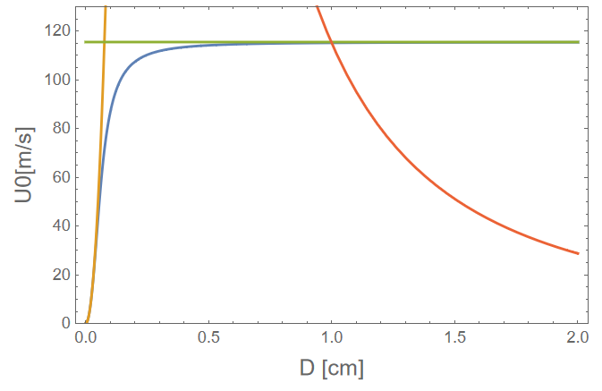
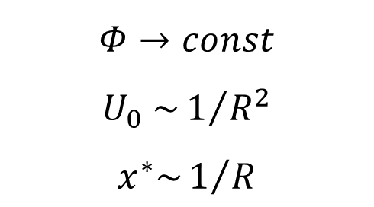
The human
$$Φ→const$$
$$U_{0} \sim 1/{R^{2}}$$
$$x^{∗}\sim 1/R$$
x*(U₀, D)
Δp
Human
U₀(Φ,D)
Φ(Δp, D₀, L₀)

Slide 13
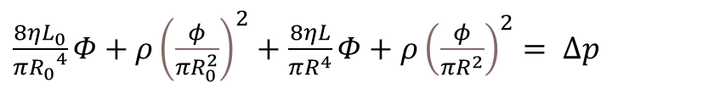
The human
$\frac{8ηL_{0}}{π{R_{0}}^{4}}Φ+ρ{\left(\frac{φ}{πR_{0}^{2}}\right)}^{2}+$ $\frac{8ηL}{πR^{4}}Φ+ρ{\left(\frac{φ}{πR^{2}}\right)}^{2}= Δp$
Solve for Φ
x*(U₀, D)
Δp = Δp₁ + Δp₂
Human
U₀(Δp,D₀,L₀,D,L)
Δp₁
D₀, L₀
D, L

Slide 14
The human

Slide 15
It all comes together
The human
The air jet
The pipe
The candle

Slide 16
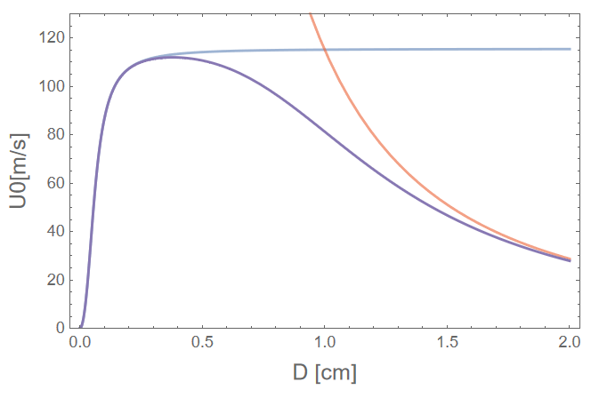
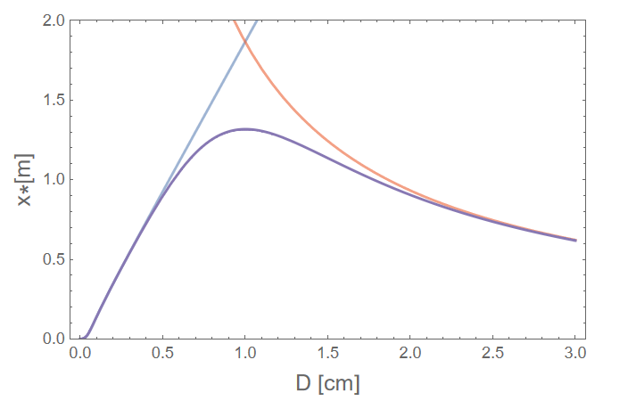
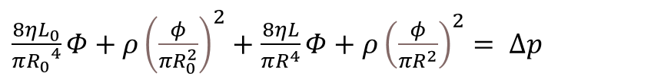
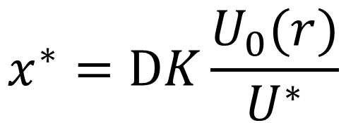
Theoretical results
$$x^{∗}=DK\frac{U_{0}(r)}{U^{∗}}$$
$\frac{8ηL_{0}}{π{R_{0}}^{4}}Φ+ρ{\left(\frac{φ}{πR_{0}^{2}}\right)}^{2}+$ $\frac{8ηL}{πR^{4}}Φ+ρ{\left(\frac{φ}{πR^{2}}\right)}^{2}= Δp$

Slide 17
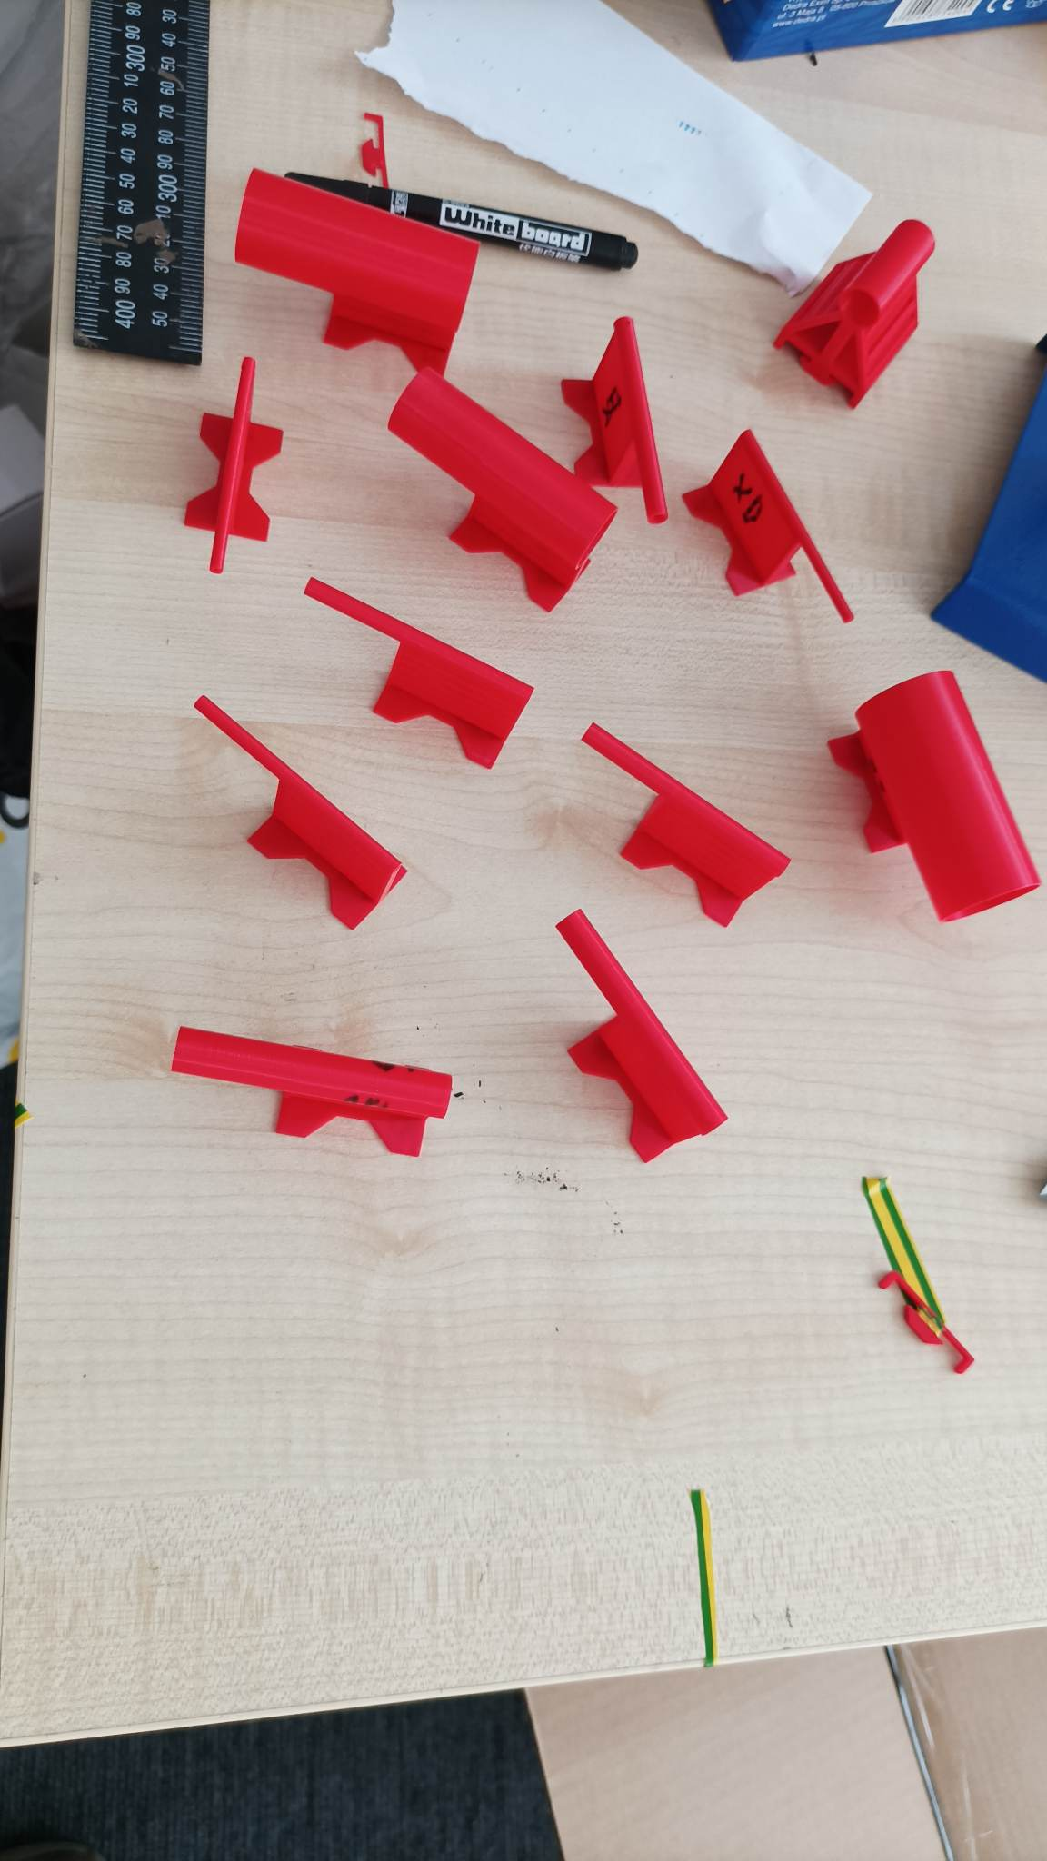
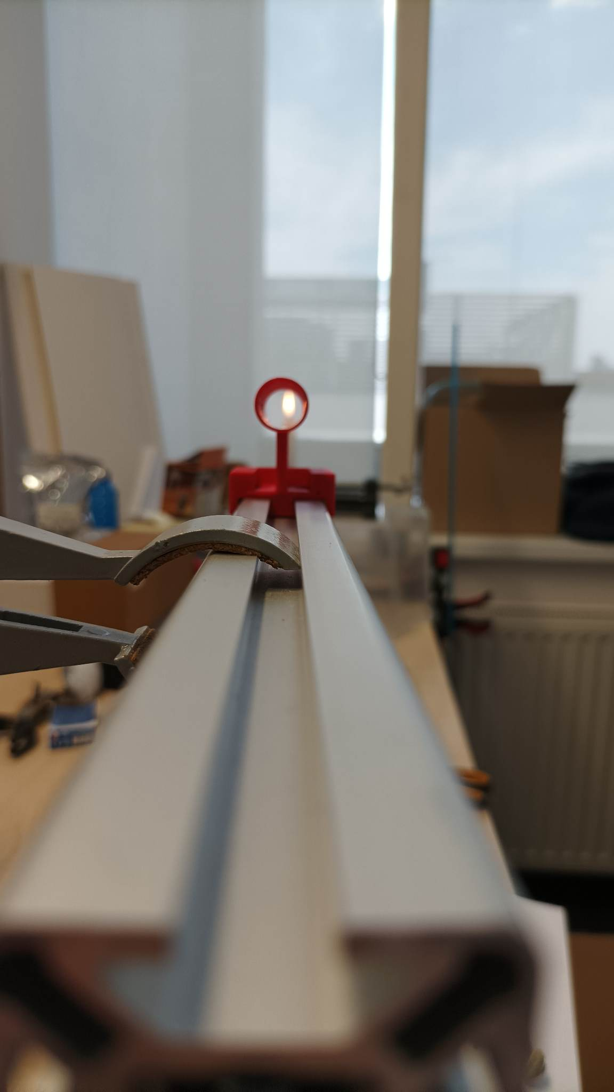
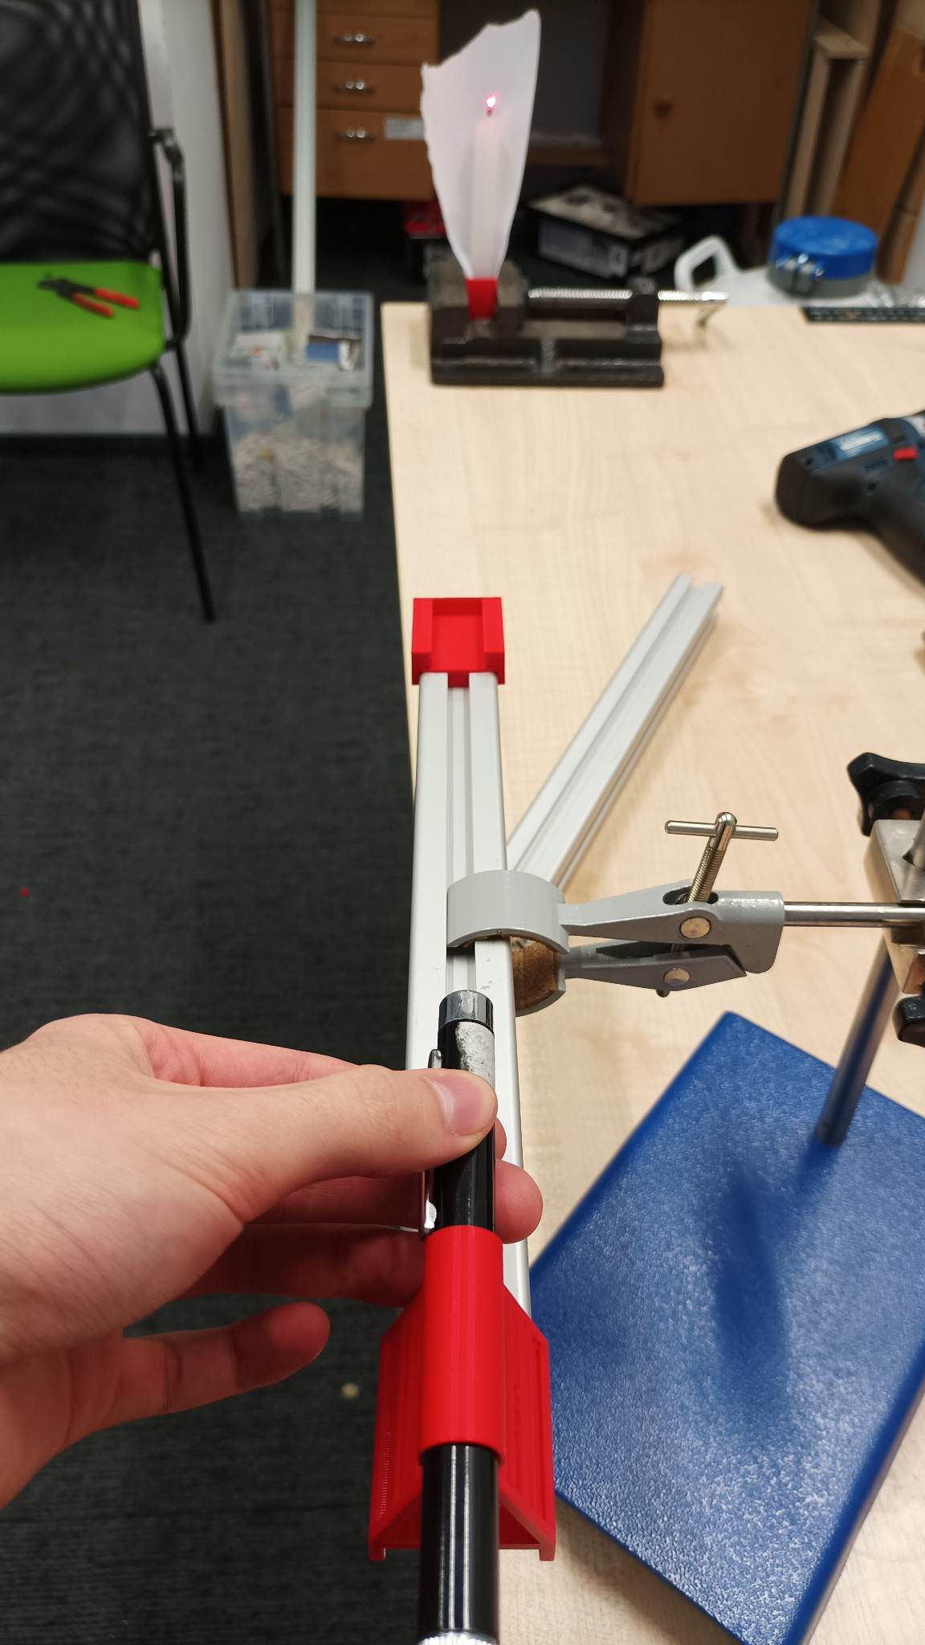
Experimental results

Slide 18
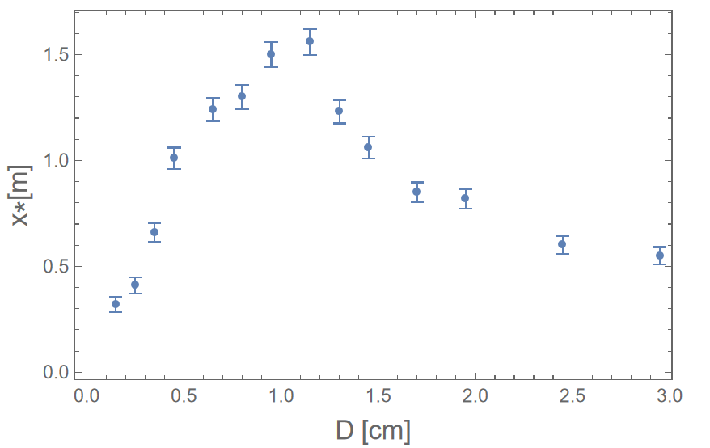
Experimental results

Slide 19
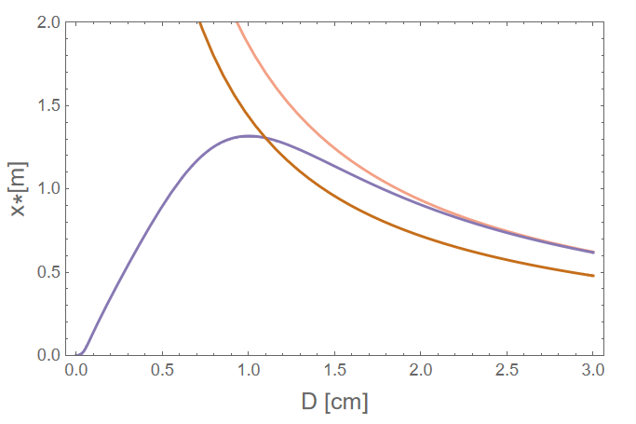

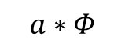
Air blast?
Time it takes to exhale
≈ a
Jet formation time
$$Φ$$
$$a∗Φ$$
Also, K is not constant for small Re

Slide 20
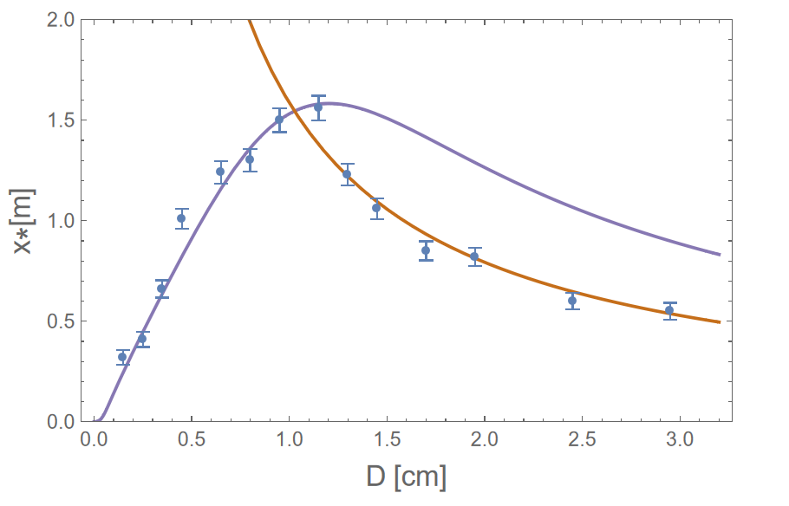
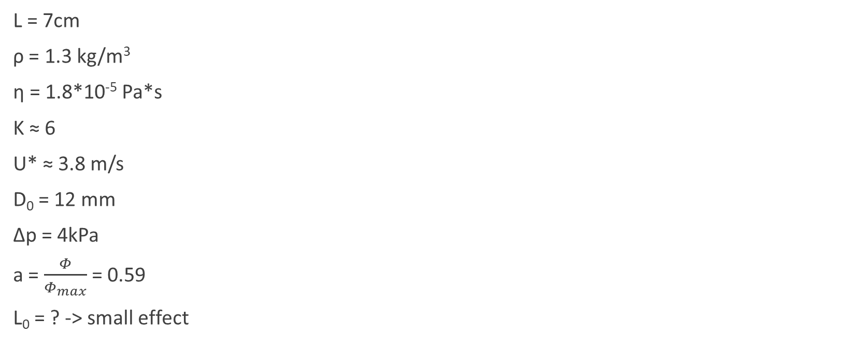
Finding the right parameters
L = 7cm
ρ = 1.3 kg/m³
η = 1.8*10⁻⁵ Pa*s
K ≈ 6
U* ≈ 3.8 m/s
D₀ = 12 mm
Δp = 4kPa
a = $\frac{Φ}{Φ_{max}}$ = 0.59
L₀ = ? -> small effect
Fitted

Slide 21
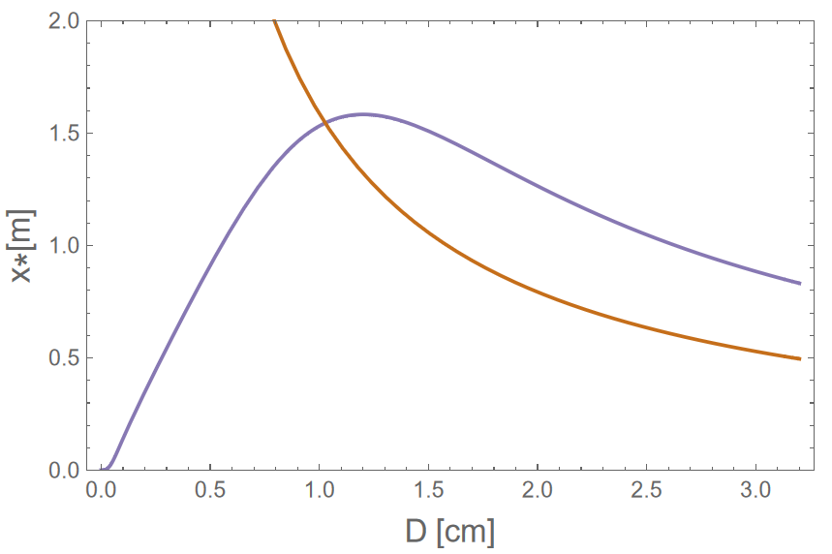
The optimal pipe
The optimal D seems to be D₀
For large D, lung capacity is the limiting factor
For small and medium D, the main factor is the pressure drop due to sudden narrowing
D₀=1.2cm

Slide 22
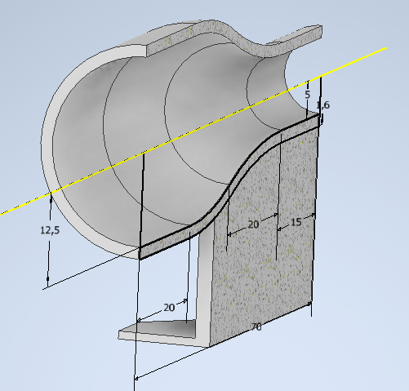
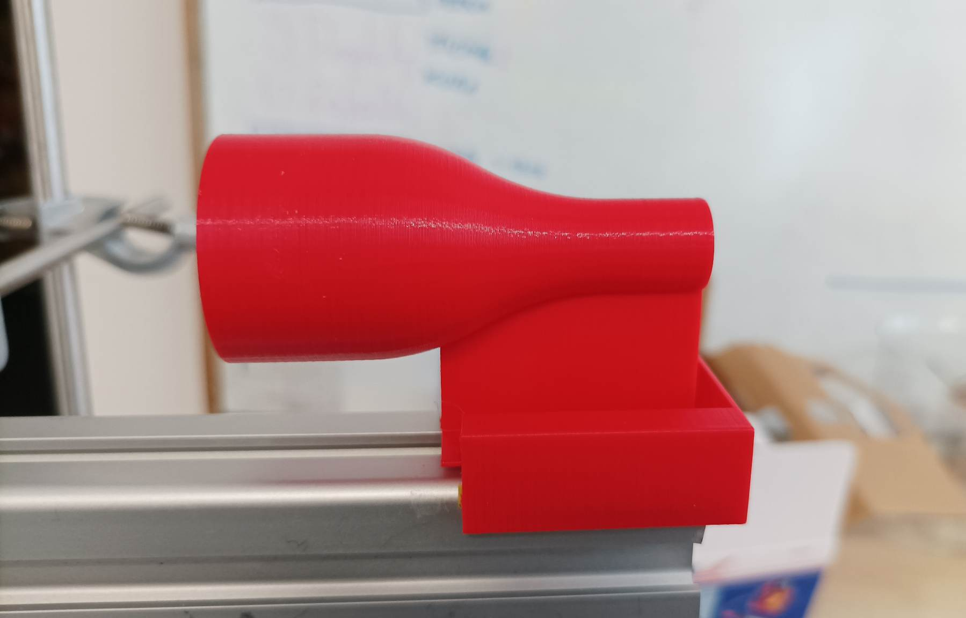
An even better pipe
From 1.5 m to 1.75 m!

Slide 23
Summary
We decomposed the problem to 4 stages
We combined models of these stages to get U₀ and x*
We performed experiments and fitted the theoretical results
We found the optimal diameter D for cylindrical pipe at 1.2 cm

Slide 24
Electric circuit analogy
Δp ~ Voltage
Φ ~ Intensity
Lungs
Trachea
Pipe
a₀+b₀*I
a(R)+b(R)*I
Battery
Internal resistance
Resistor

Slide 25

Electric circuit analogy
Δp ~ Voltage
Φ ~ Intensity
$$Δp =\frac{8ηL}{πR^{4}}Φ+ρ{\left(\frac{φ}{πR^{2}}\right)}^{2}$$
Lungs
Trachea
Pipe
Lung volume ~ charge!
a₀+b₀*I
a(R)+b(R)*I
Condensator
Internal resistance
Resistor

Slide 26
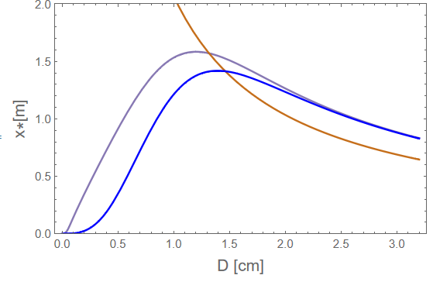
The optimal pipe - Length
The optimal D seems to be D₀
Increasing L has some, but small effect
However, increasing L increases the blowing time required!
L=7cm
L=7m
D₀=1.2cm

Slide 27
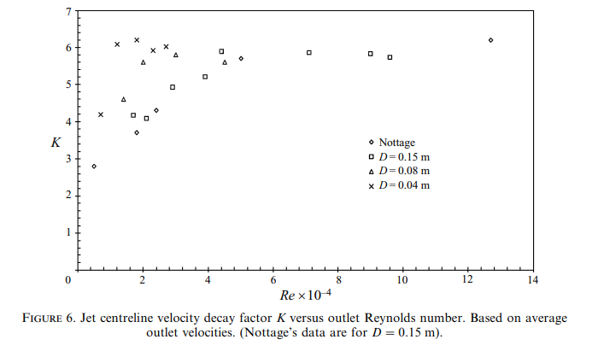
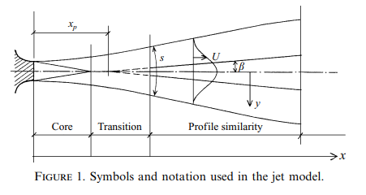
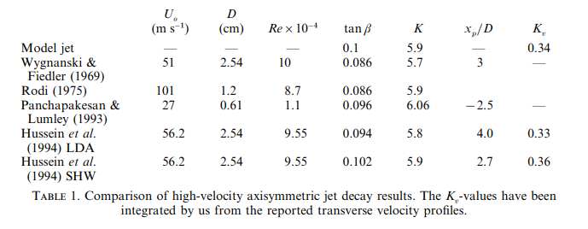
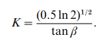
Centreline velocity decay measurements in low-velocity axisymmetric jets
TOR G. MALMSTRÖM, ALLAN T. KIRKPATRICK, BRIAN CHRISTENSEN and KEVIN D. KNAPPMILLER, 1997

Slide 28
Reynolds number
1cm, 100m/s -> Re ~ 10*10⁴
3cm, 10m/s -> Re ~ 3*10⁴

Slide 29
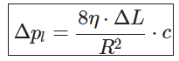
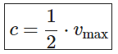
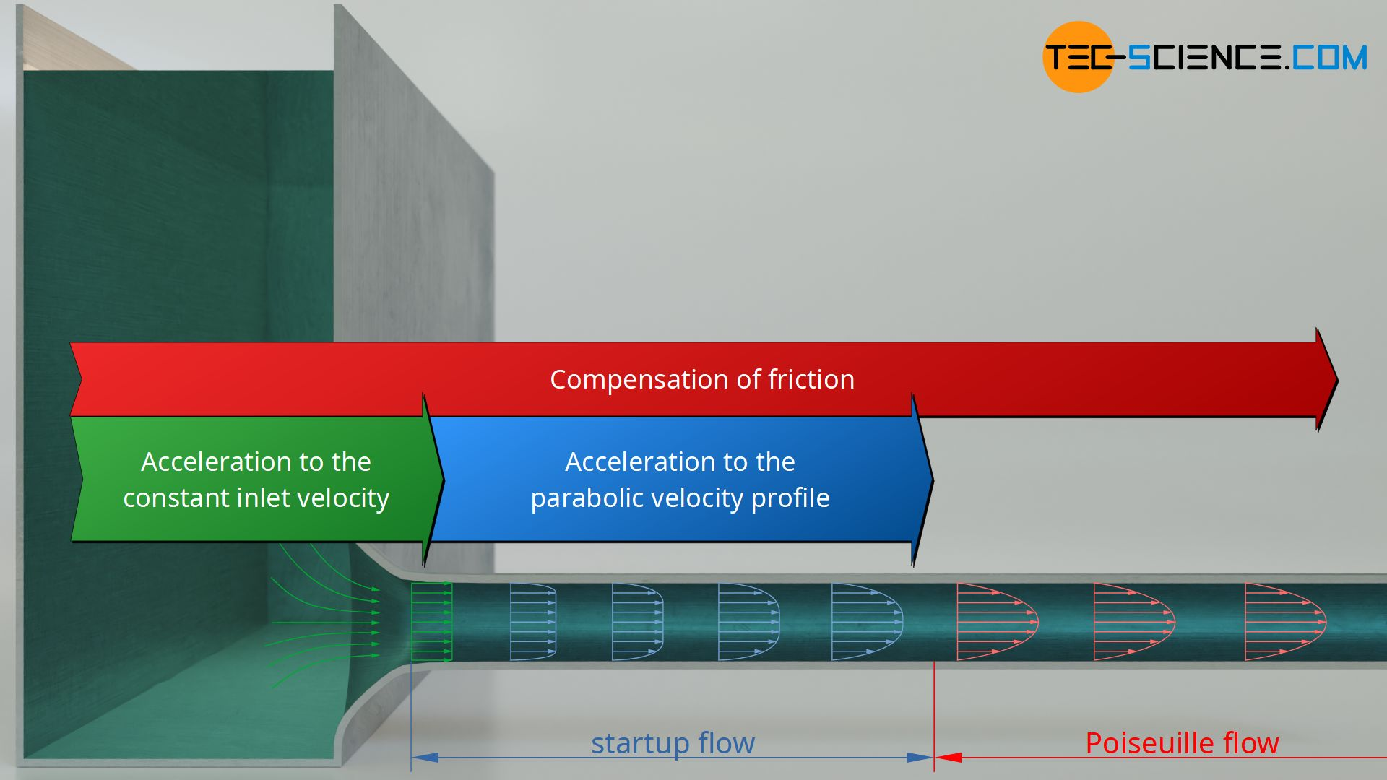
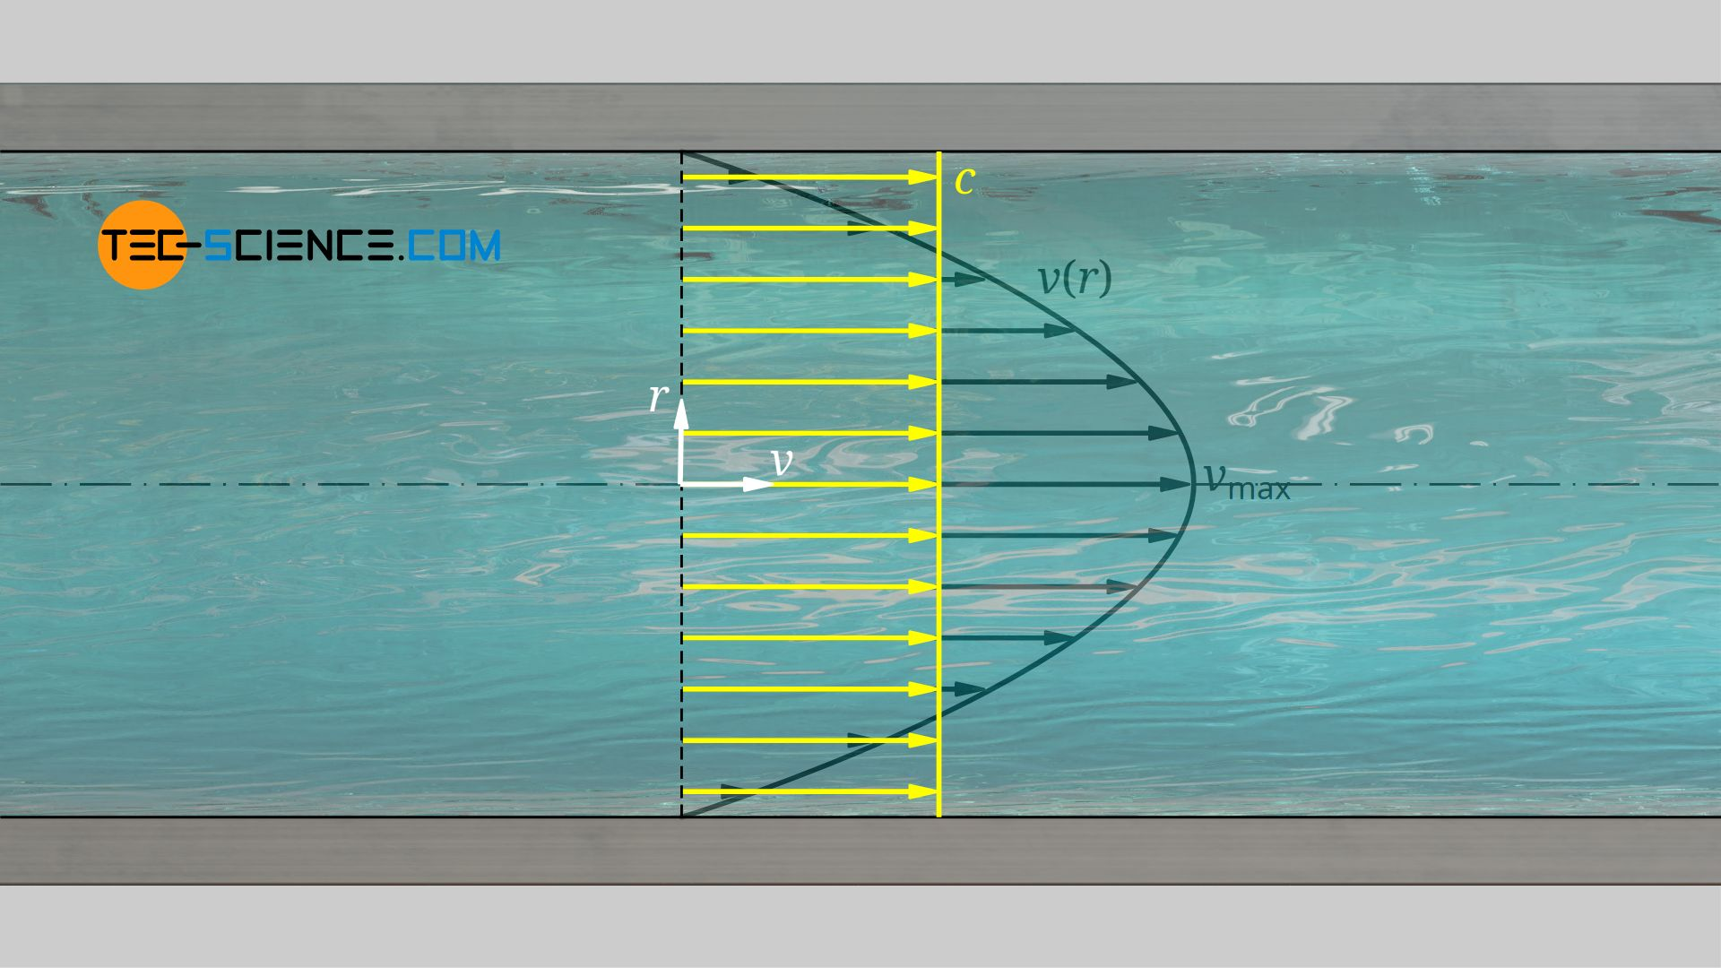
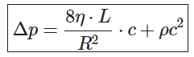
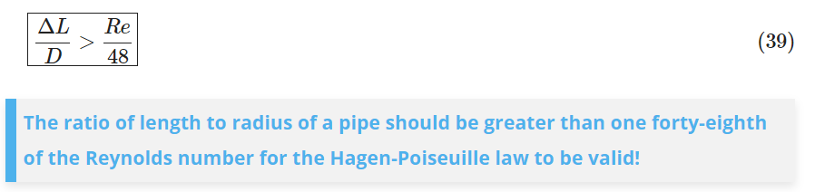
Hagen-Poiseuille
Hagen-Poiseuille law
https://www.tec-science.com/mechanics/gases-and-liquids/hagen-poiseuille-equation-for-pipe-flows-with-friction/
https://www.tec-science.com/mechanics/gases-and-liquids/energetic-analysis-of-the-hagen-poiseuille-law

Slide 30


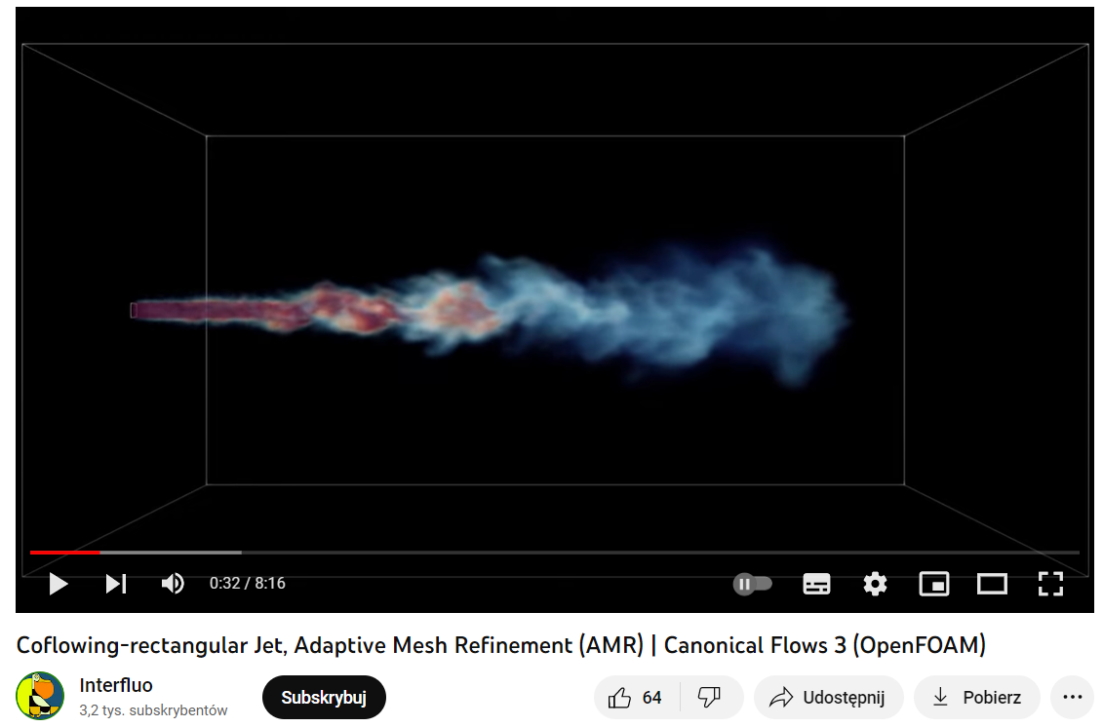

Simulations
https://youtu.be/YHZtjdgBzdQ?t=24

Slide 31
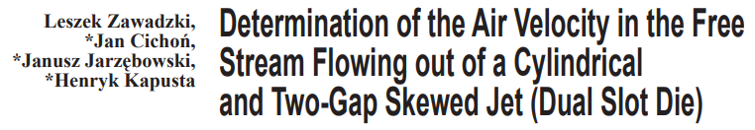
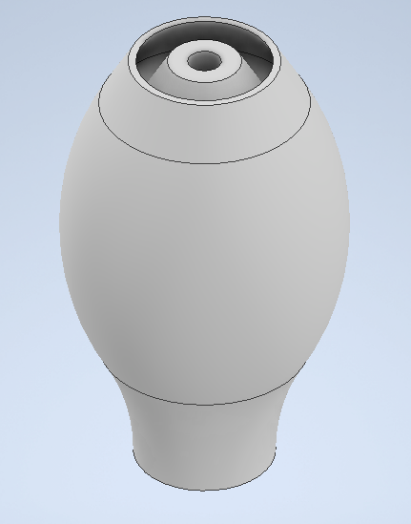
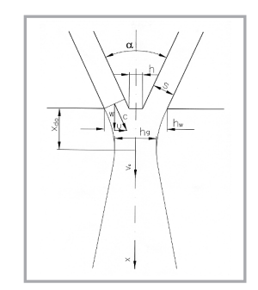
Other ideas

Slide 32
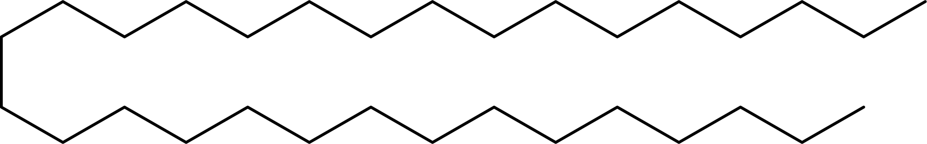
The candle
Blowing removes the wax particles in the air necessary to continue burning
U*
Wax particle
Wind tunnel

Slide 33

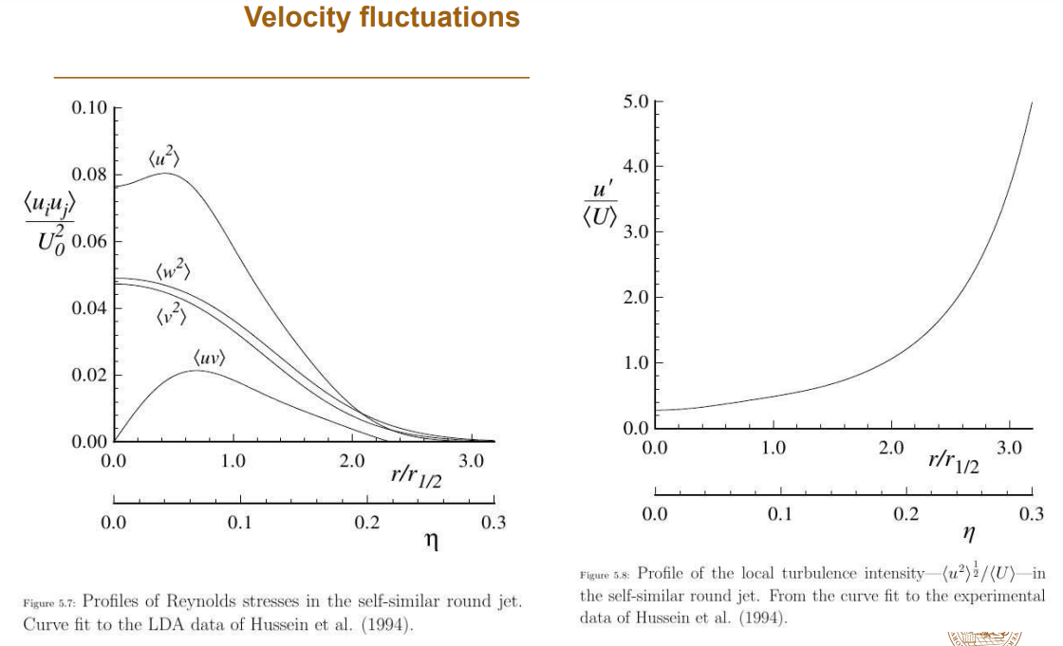
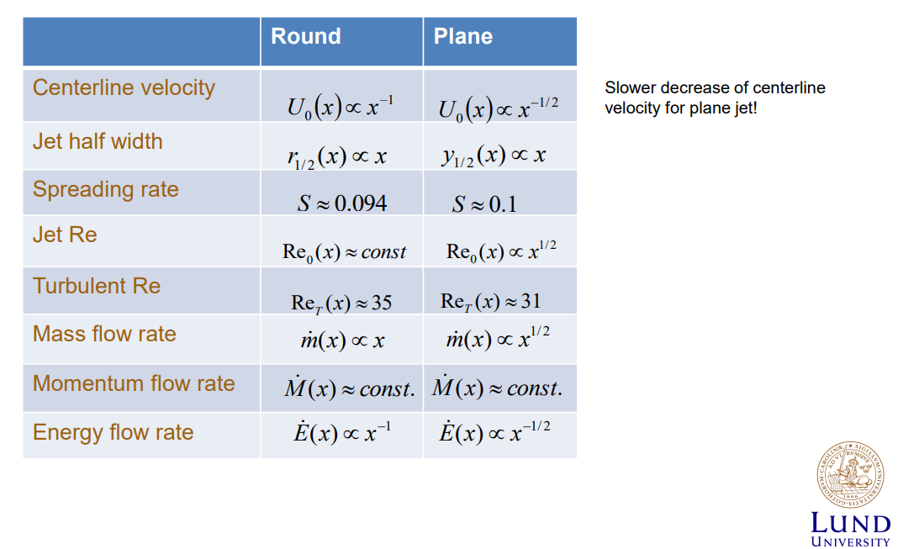

Slide 34





Slide 35


Slide 36

Darcy - Weisbach

